Slide 1
Application of Thermal Spray
Presented by: John Kern, SSPC

Slide 2
What is Thermal Spray?
Coating processes in which melted (or heated) materials are sprayed onto a surface.

Slide 3
NACE NO.12/AWS C2.23M/SSPC CS-23 STANDARD PRACTICE
Specification for the Application of Thermal Spray Coatings (Metallizing) of Aluminum, Zinc, and Their Alloys and Composites for the Corrosion Protection of Steel

Slide 4
Scope
Provides a procedure for the application of metallic thermal spray coating (TSCs) of aluminum, zinc, and their alloys and composites for the corrosion protection of steel
Required equipment, application procedures, and in-process quality control (QC) checkpoints are specified.

Slide 5
Scope
Included are requirements for:
Job reference standard
Surface preparation
Coating application
Repair of coating defects
Measurement of coating thickness
Adhesion testing of the applied coating
Application of sealers and topcoats over the thermally sprayed metal coating

Slide 6
Application Procedure
The TSC applicator shall submit an application procedure proposed for the contract work including information on:
The equipment capabilities
Materials
Process or application procedures
In‑process quality control checkpoints for:
Surface preparation
Thermal spraying
Paint work (sealer or sealer and topcoat)

Slide 7
Job Reference Standard
Prepared prior to application of thermal spray coating
Made with the actual field equipment and the process parameters and procedures (surface preparation and thermal spraying) to be used for the contracted work
Retained until the job is completed

Slide 8
Job Reference Standard

Slide 9
Job Reference Standard
Measure thermal spray thickness and adhesion
Thickness
One spot measurement at the center and one in each quadrant (5 total); each measurement is the average of at least three readings
Satisfactory if the average of the five measurements is at least equal to the contract-specified thickness and no individual measurement is less than 80% of the contract-specified thickness

Slide 10
Job Reference Standard
Adhesion
Five adhesion measurements (one at the center and one in each quadrant)
Satisfactory if the average of the five measurements is at least equal to the contract-specified minimum tensile adhesion and no individual measurement is less than 80% of the contract-specified adhesion

Slide 11
ASTM D4285
Standard Test Method for Indicating Oil or Water in Compressed Air
This test method is used to determine the presence of oil or water in compressed air used for abrasive blast cleaning, air blast cleaning, and coating application operations

Slide 12
Minimum Pre-Surface Preparation Requirements

Slide 13
Surface Preparation
Pre-Surface Preparation
The steel surface temperature shall be at least 3 °C (5 °F) above the dew point temperature of the ambient air
Verify the cleanliness of compressed air in accordance with ASTM D4285.

Slide 14
Surface Preparation
Immersion Service
White metal finish, SSPC-SP 5/NACE No. 1
Non-Immersion Service
Near-white metal finish, SSPC-SP 10/NACE No. 2

Slide 15
Surface Preparation
Non-Visible Contaminants
The level of nonvisible contamination specified in the procurement documents
For guidance on methods used for measuring see SSPC Guide 15, Field Methods for Extraction and Analysis of Soluble Salts on Steel and Other Nonporous Substrates

Slide 16
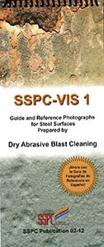
Verification of Cleanliness
Verify the level of cleanliness achieved using SSPC VIS 1, Guide and Reference Photographs for Steel Surfaces Prepared by Dry Abrasive Blast Cleaning

Slide 17
Surface Profile
Minimum depth of 65 µm (2.5 mil)
Maximum depth of 125 µm (5.0 mil)
Measured in accordance with SSPC-PA 17, using ASTM D4417 Method B (depth micrometer) or Method C (replica tape)

Slide 18
Surface Profile
SSPC-PA 17, Procedure for Determining Conformance to Steel Profile/Surface Roughness/Peak Count Requirements
ASTM D4417, Standard Test Methods for Field Measurement of Surface Profile of Blast Cleaned Steel
Method A, Visual Comparison
Method B, Digital depth micrometer
Method C, Replica Tape

Slide 19
Minimum Surface Preparation Requirements

Slide 20
Application
The specified coating thickness shall be applied in several overlapping passes
The acceptability of the total TSC shall be confirmed by tensile adhesion testing
No moisture condensation on the surface is permissible at any time during thermal spraying
Notes:
pipio

Slide 21
Repair
Feather the damaged area to achieve an approximately 50 mm to 75 mm (2 to 3 in.) overlap of the new work into the existing TSC
Apply TSC to the newly prepared surfaces, and overlap the existing TSC to the extent of the feathered edge so the overlap is a consistent thickness

Slide 22
Measurement of Coating Thickness
Measured in accordance with SSPC-PA 2 Coating Thickness Restriction Level 4
80% of the minimum and 150% of maximum DFT range
If the steel substrate is not ferromagnetic, TSC thickness shall be measured on a companion coupon of ferromagnetic steel

Slide 23
Nonconforming TSC Thickness
Less than the contract requirement
Apply additional TSC to meet the thickness requirement
Greater than the contract specification
Recorded in the JCR (Job Control Record)
If greater than 150% of the specified range, the adhesion properties shall be assessed per ASTM D4541 Method C, D, E, or F
Disposition of the nonconformance shall be agreed to by the owner

Slide 24
Adhesion

Slide 25
Adhesion
One portable tensile adhesion measurement (average of three pulls) shall be conducted on the unsealed TSC on the production piece or on a companion (Job Reference Standard) coupon sprayed at the same time for each 50 m² (550 ft²)

Slide 26
Thermal Spray Finish
When compared with the accepted job reference standard, the deposited TSC shall be uniform without blisters, cracks, loose particles, or exposed steel as examined with 10x magnification
Note - Unsealed TSC may develop discolored areas or light rust stain in the porosity of the coating once exposed to an increased level of humidity

Slide 27
Minimum Application Requirements

Slide 28
Additional Tests
Bend Test
Hammer Test

Slide 29
Bend Test
A qualitative test for proper surface preparation, equipment setup, and spray parameters. The bend test puts the TSC in tension.

Slide 30
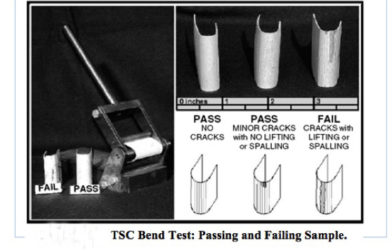
Bend Test

Slide 31
Bend Test

Slide 32
Hammer and Chisel Test
A procedure to identify areas of metallized coating that are poorly adhering to the substrate
The procedure involves impacting the coating with blow from a hammer weighing approximately 1.3 kg (3 lb.) to a 38 mm (1.5 in.) masonry chisel
Any disbonding or peel of the coating as the result of the blow is considered a failure

Slide 33
Hammer and Chisel Test

Slide 34
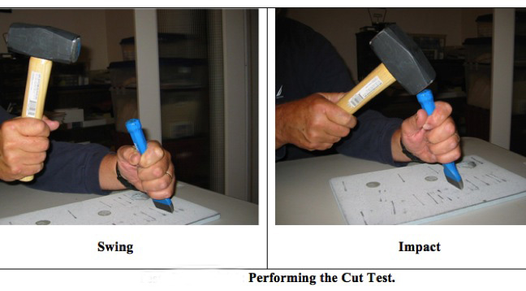
Hammer and Chisel Test

Slide 35
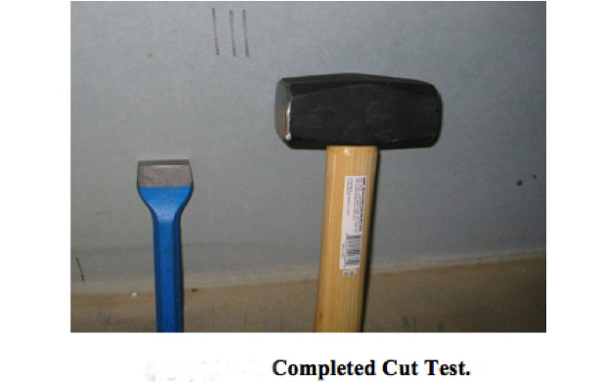
Hammer and Chisel Test

Slide 36
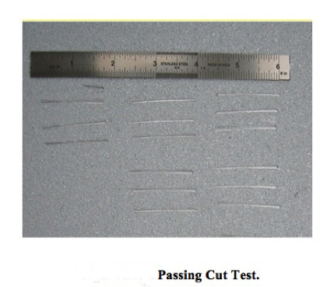
Hammer and Chisel Test

Slide 37
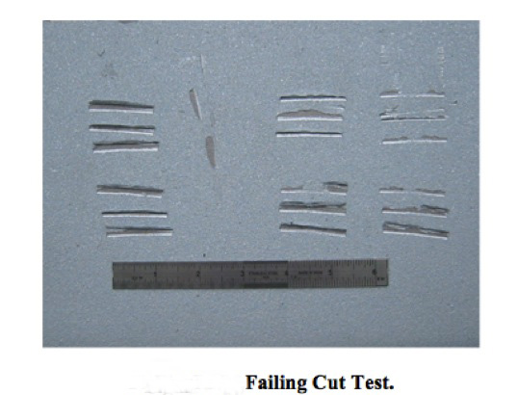
Hammer and Chisel Test

Slide 38
Application of Optional Sealers and Topcoats
Sealer
Apply within 8 hours of TSC application
Apply over a dry, clean, and dust-free surface
Verified by visual examination of a clean white cloth
Capable of penetrating into the body of the TSC to seal the interconnected surface porosity

Slide 39
Application of Optional Sealers and Topcoats
Topcoat
Chemically compatible with the sealer and shall be applied in accordance with the paint manufacturer’s instructions
Apply IAW SSPC-PA 1

Slide 40
SSPC-PA 1
Shop, Field, and Maintenance Painting of Steel
The scope of this specification is rather broad, covering both specific as well as general requirements for the application of paint.
This specification does provide detailed coverage of the procedures and methods for application after the selection of the coating materials has been made.

Slide 41
Safety
Applicator shall follow all appropriate procedures and meet all appropriate regulatory requirements
ANSI Z49.1, Safety in Welding, Cutting and Allied Processes
NFPA 58, Standard for the Storage and Handling of Liquefied Petroleum Gases
Safety Data Sheets (SDSs)

Slide 42
Any Questions
??????????????????

