Slide 1
Selecting the Right Abrasive Presented by: Earl Bowry Newport News Shipbuilding

Slide 2
Learning Outcomes
At the end of this webinar, you will be able to:
Define types of abrasive
Recognize industry standards for different types of abrasives
Define abrasive characteristics and how they effect abrasive selection and productivity per specific job
Notes:
In order to select the correct abrasive for a particular job a number of factors need to be understood. This Webinar will cover these factors and how they influence the appearance, cleanliness and profile of the finished surface.
During this Webinar I will be discussing the types of available abrasives along with some of the benefits and negatives of each and the factors that control productivity. I will also cover the industry standards for the basic types of abrasives.

Slide 3
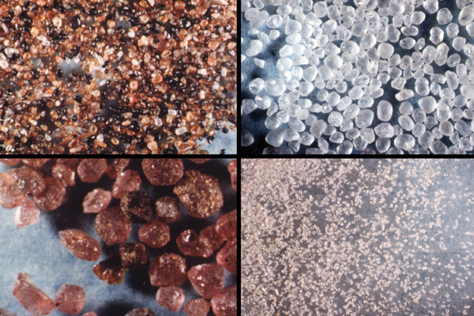
Notes:
There are a large number of abrasives available for use thought-out the world.
Some may only be regionally available due to the high cost of transporting them long distances.
Some abrasives, even when described as the same type of abrasive, can have different properties based on the location they come from.

Slide 4
Abrasive Types – Major Categories
Non-metallic
Mineral
Slag
Organic
Manufactured
Metallic
Steel grit
Steel shot
Iron grit
Notes:
Abrasives for blast cleaning are generally broken down into Two major categories:
Non-Metallic
Metallic

Slide 5
Mineral Abrasives
Mined or quarried, naturally-occurring:
Garnet
Olivine
Staurolite
Silica Sand

Slide 6
Mineral Abrasives
Hard and brittle
Fracture on impact, generating high dust levels
Dust generation and abrasive breakdown at elevated nozzle pressures is a potential problem
Notes:
Generally speaking the hard mineral abrasives have several negatives:
They are brittle causing them to fracture when they strike the surface and break into small particles'. These small particulars spread out as dust and can be hazardous to health and vision

Slide 7
Organic Abrasives
Organic by-products such as:
Walnut shells
Corn cobs
Peach pits
Notes:
Some of the more common examples of these include Walnut Shells, Corn cobs and Peach pits.
After using these types of abrasives you will need to test for and remove any oil residue that may be left.
Organic abrasives can also break down in the small dust causing particles.

Slide 8
Organic Abrasives
Used to remove lightly adhering coatings without damaging the substrate
Do not usually impart a surface profile
Notes:
A common use for these is cleaning electrical equipment and for removing paint from airplane outer skins

Slide 9
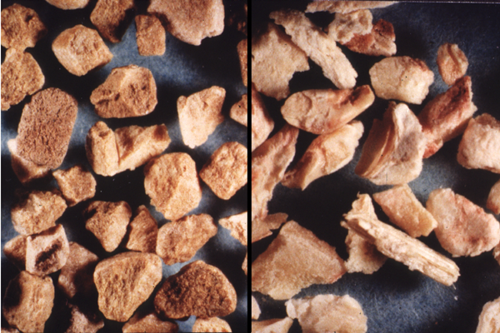
Walnut Shells
Corn Cob
Notes:
Photo of organic abrasives (magnified): walnut shells (left), corn cob (right)

Slide 10
Manufactured Abrasives
Aluminum oxide
Baking soda
Ground cullet (glass)
Silicon carbide
Plastic pellets
Dry ice
Sponge jet

Slide 11
Manufactured Abrasives
Generally more costly than natural or by-product abrasives
Used primarily for specialized applications in which a particular surface finish is required that justifies the extra cost

Slide 12
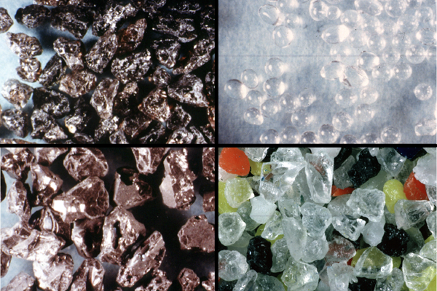
Notes:
Examples of non-metallic manufactured abrasives

Slide 13
By-Product Abrasives
Slags:
Coal
Smelter
Copper
Nickel

Slide 14
By-Product Slag Abrasives, cont.
Slags:
By-products
Composition varies, depends on source
A form of glass
Fracture into sharp, angular particles
Widely used substitute for sand

Slide 15
By-Product Slag Abrasives, cont.
Slags:
Dust generation and abrasive breakdown at elevated nozzle pressures is a potential problem

Slide 16
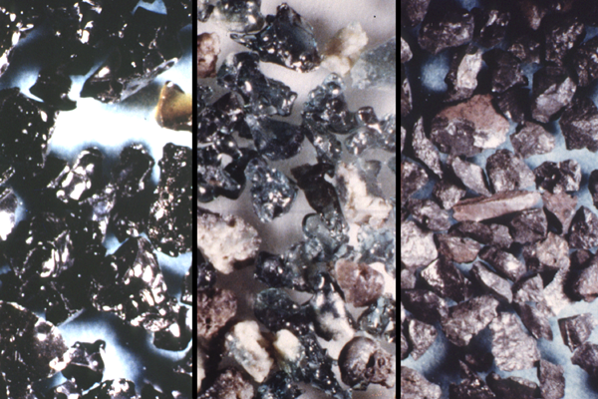

Slide 17
Metallic Abrasives
Steel shot – round
Iron or steel grit – angular or irregular
Used extensively in the blast cleaning industry for the removal of paint, rust, mill scale and other surface contaminants from steel surfaces prior to painting
Must be dry – will rust if wet
Can be recycled many times in a dry environment

Slide 18
Metallic Abrasives, cont.
Brass, aluminum, and zinc abrasives are used primarily for specialized applications not related to paint and rust removal

Slide 19
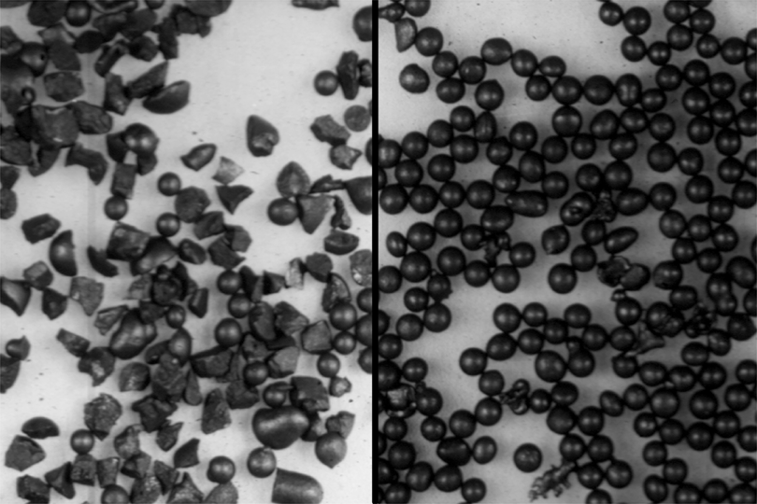

Slide 20
Selecting Appropriate Abrasive
Type of abrasive selected influences:
Appearance of blast-cleaned surface
Productivity
Subsequent clean up

Slide 21
Abrasive Specifications
SSPC-AB 1
SSPC-AB 2
SSPC-AB 3
SSPC-AB 4

Slide 22
Abrasive Specifications, cont.
SSPC-AB 1:
Defines requirements and references test methods for selecting and evaluating mineral and slag abrasives

Slide 23
Abrasive Specifications, cont.
SSPC-AB 2:
Defines requirements and references methods for testing cleanliness of recycled ferrous metallic abrasives

Slide 24
Abrasive Specifications, cont.
SSPC-AB 3:
Defines requirements for testing ferrous metallic (iron and steel) abrasives

Slide 25
Abrasive Specifications, cont.
SSPC-AB 4
Defines requirements for selecting and evaluating abrasive media encapsulated in a compressible non-uniform cellular matrix

Slide 26
Abrasive Characteristics
Hardness
Size
Shape
Bulk density
Friability/waste generation
Recyclability

Slide 27
Hardness
Harder abrasives:
Tend to cut or etch the surface
May break down faster, creating more dust and embedment of abrasive into the surface
Softer abrasives:
Tend to polish the surface

Slide 28
Hardness, cont.
Metallic abrasive hardness:
Measured on the Rockwell C scale
Nonmetallic abrasive hardness:
Measured on the Mohs scale

Slide 29
Typical Hardness of Iron and Steel Abrasive
Steel shot
40-50 Rockwell C
Steel grit
55-60 Rockwell C
Iron grit
55-60 Rockwell C

Slide 30
Comparative Abrasive Hardness
Abrasive Hardness (Mohs)
Silicon Carbide 9.0
Aluminum Oxide 8.0-9.0+
Garnet 7.0-8.0
Copper Slag 7.0-7.5
Nickel Slag 7.0-7.5
Coal Slag 7.0-7.5
Ferric Oxide 6.5-7.0
Flint 6.5-7.0
Glass Beads 5.0-6.0
Nut Shells 3.0-3.5
Plastic Grit 3.0-4.0
Corn Cobs 2.0-4.5

Slide 31
Size of Abrasive
Affects profile
Affects number of impacts per pound of abrasive

Slide 32
Shape of Abrasive, cont.
Spherical to round particles clean by impact, producing a peened surface
Angular to irregular shaped particles clean by scouring or cutting the surface, producing an etched or sharply angular surface

Slide 33
Shape of Abrasive, cont.
In general, angular abrasives work well for removing heavy layers of paint and corrosion
More rounded abrasives work well for removing mill scale and lighter corrosion

Slide 34
Bulk Density
Bulk density:
A measure of an abrasive’s weight per unit volume
Usually expressed in pounds per cubic foot
Sand weighs approximately 100 lb/ft³
Coal slag weighs approximately 90 lb/ft³
Steel grit abrasives weighs approximately 250-280 lb/ft³
Affects energy of each particle

Slide 35
Friability/Waste Generation
Friability:
A measure of an abrasive's resistance to breakdown on impact
Affects recycling
Affects amount of dust
The more friable an abrasive, the greater the tendency for the abrasive to breakdown on impact, generating more waste and dust

Slide 36
Friability/Waste Generation, cont.
Most mineral and byproduct abrasives can be recycled a limited number (1-3) of times
Steel abrasives, on the other hand show the lowest friability, generate the least amount of waste, and can be recycled many times

Slide 37
Friability/Waste Generation, cont.
Harder, less friable, recyclable abrasive, such as garnet and steel, tends to embed more when blasted dead on
Changing the blasting angle to 60° or less and sweeping the surface as you would in a brush off blast can reduce embedment while increasing productivity
Notes:
.

Slide 38
Recyclability
Iron and steel abrasive can be recycled several hundred times
Garnet can be recycled a few times
Mineral and slag abrasives are not normally recycled

Slide 39
Recyclability, cont.
SSPC-AB 2:
Describes cleanliness requirements for recycled iron and steel abrasives

Slide 40
SSPC AB-2
Covers the requirements for cleanliness of recycled ferrous blast cleaning abrasives
Three representative samples collected at three different times during each reclamation cycle, or during an 8 hour period

Slide 41
Recyclability, cont.
Section 6 of the SSPC/NACE Blast Cleaning Standards (e.g., SP-10) require both recyclable and expendable abrasive to be clean, dry, and free of oil, grease, and other contaminants as determined by the test methods found in SSPC-AB 1, AB 2, AB 3 and AB 4

Slide 42
Surface Profile
Important for adhesion
Definition
Factors that affect profile depth
Measurement methods

Slide 43
Surface Profile, cont.
The facility owner specifies profile based on coating manufacturer recommendations
The profile to be specified depends on the generic coating type and the dry film thickness of the coating

Slide 44
Factors That Affect Profile Depth
Abrasive size
Abrasive type
Abrasive hardness
psi (air pressure) at the nozzle
Nozzle to surface distance

Slide 45
Factors That Affect Profile Depth, cont.
It is good practice to conduct trials before getting started to see what size and type of abrasive as well as what air pressure at the nozzle and distance and angle of attack are required to meet the specification
It is poor practice to create a profile deeper than specified and then re-blast to knock down the profile to get the required profile depth. This practice is very inefficient in that it not only increases costly rework but it also decreases the quality of the original surface profile

Slide 46
Factors That Affect Profile Depth, cont.
Profile ranges are stated by the coating manufacturer or facility owner for a purpose: to obtain maximum adhesion or bonding of the coating to the steel
When possible, consult your abrasive or blast machine equipment supplier’s technical representative for advice on abrasive size, type, and hardness, blasting pressure, cleaning angle, nozzle size, and distance from the surface in order to get the best quality job done at the lowest price

Slide 47
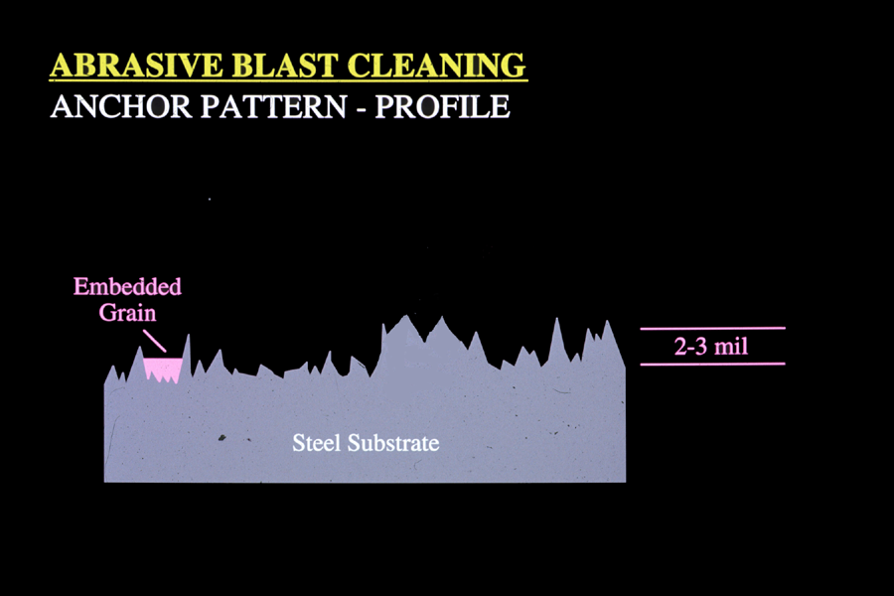
Notes:
Profile Illustration - exaggerated vertical view of angular or etched profile.

Slide 48
Productivity
Productivity is important because it can save time and often that translates into money savings for the contractor

Slide 49
Productivity, cont.
Abrasive characteristics and their influence on production are summarized here:
Particle size
Hardness
Shape
Bulk density
Nozzle pressure
Nozzle type

Slide 50
Productivity, cont.
Particle size:
Decreasing abrasive particle size can dramatically increase cleaning rate because more particles are impacting the surface per unit time compared to a coarser abrasive
Increasing abrasive size may be necessary to remove heavy coatings and scale
The general rule is to use the smallest size abrasive that will do the job

Slide 51
Productivity, cont.
Hardness:
In general, the harder an abrasive, the better it will perform on difficult to clean areas. However, very hard abrasives may shatter on impact expending most of the energy in particle disintegration and dust generation
Along with selecting the smallest abrasive size possible, the general rule here is to select the minimum abrasive hardness that will effectively do the job. Softer metallic abrasives can be recycled more times than harder metallic abrasives

Slide 52
Productivity, cont.
Shape:
Rounded abrasive particles produce a peened surface
An angular to irregular shaped abrasive particle produces an etched or more sharply defined surface
The right shape for the job at hand can have an impact on productivity and quality of surface profile

Slide 53
Productivity, cont.
Bulk density:
The higher the abrasive bulk density the more energy it will impart to the surface and thus do more work

Slide 54
Productivity, cont.
Cleanliness:
A clean, dry, dust free abrasive is essential for optimum productivity
Check the abrasive for foreign matter, moisture and dust before starting the job

Slide 55
Summary
The type of abrasive chosen influences the surface profile, appearance and productivity of the surface. The proper abrasive selection is based on the hardness, size, shape, bulk density, friability and recyclability of the abrasive

